Slide 1
Tracing BPF_ADD

Slide 2
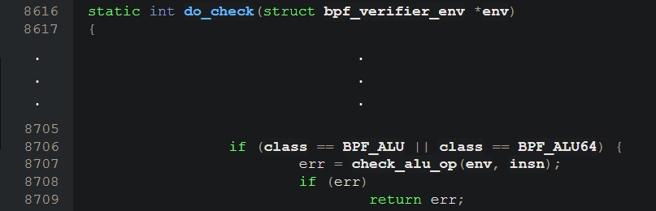
Highest level: do_check (8616-8937)
Delegates instructions to more specific check methods
In this case, delegates BPF_ADD (an ALU instruction) to check_alu_op

Slide 3
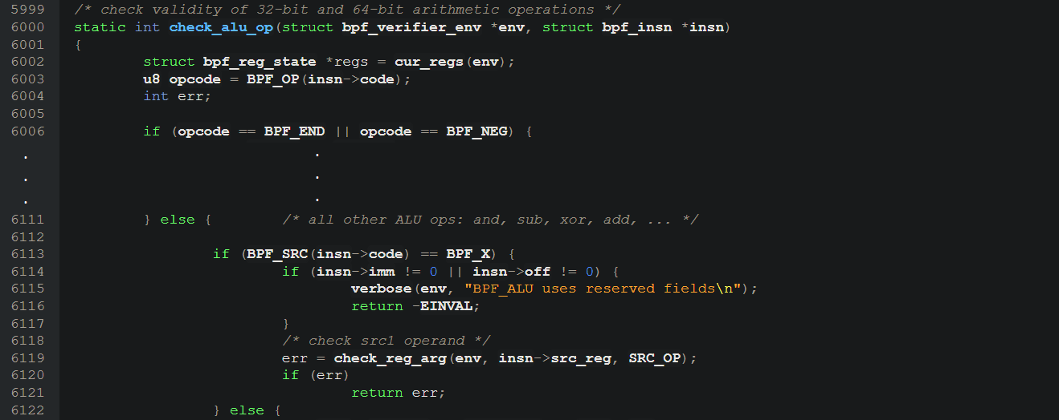
check_alu_op (6000-6159)
High level sorts and does some bound checks for ALU operations
BPF_ADD is included in the ‘else’ in L6111
Does a few explicit checks on the imm, off, and src_reg fields
Uses two submethods: check_reg_arg and adjust_reg_min_max_vals

Slide 4
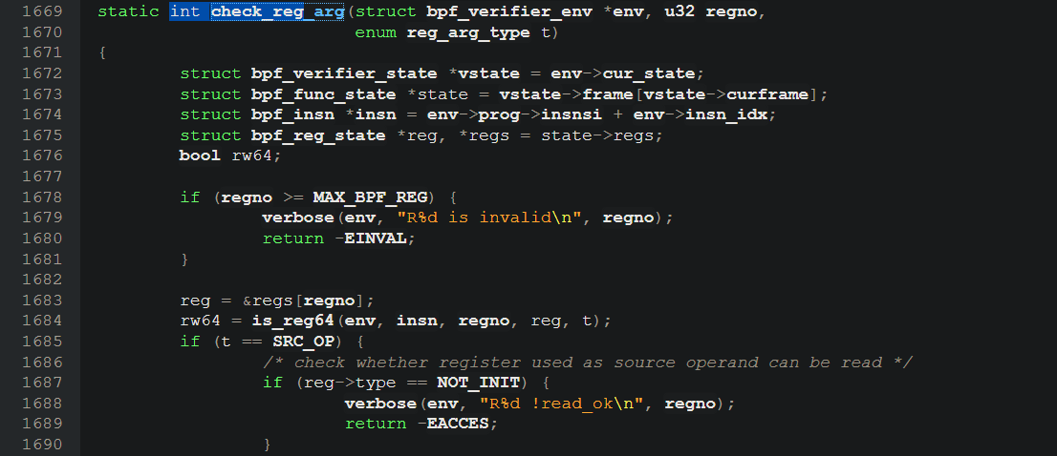
check_reg_arg (1669-1712)
Checks whether a use of a register is appropriate
Goes through a number of checks
The goal of the checks is more or less clear
Handwaving mark_insn_zext, mark_reg_read, mark_reg_unknown

Slide 5
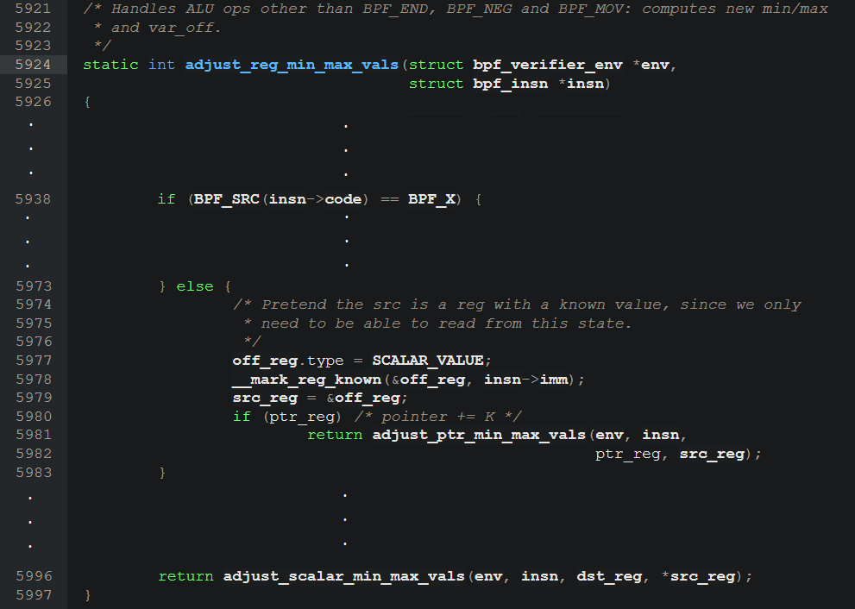
adjust_reg_min_max_vals (5924-5997)
The important part of the verification
Updates known min and max vals for a register to keep uses safe.
Delegates to adjust_ptr_min_max_vals and adjust_scalar_min_max_vals

Slide 6
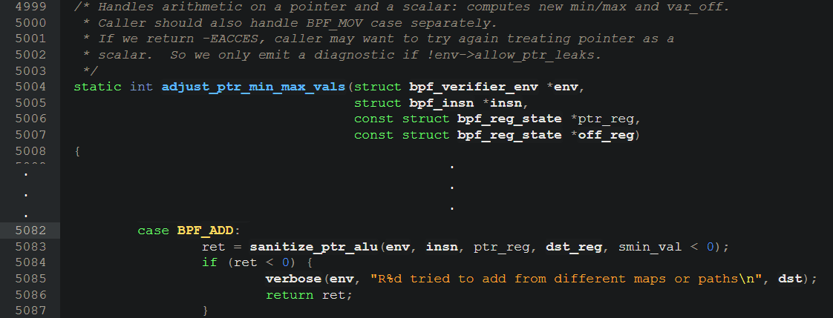
adjust_ptr_min_max_vals (5004 – 5242) case BPF_ADD: (5082-5136)
Handles arithmetic on a pointer and scalar for non-BPF_MOV ops
Doesn’t really delegate; handles most boundary updates manually
Handwaving check_reg_sane_offset

Slide 7
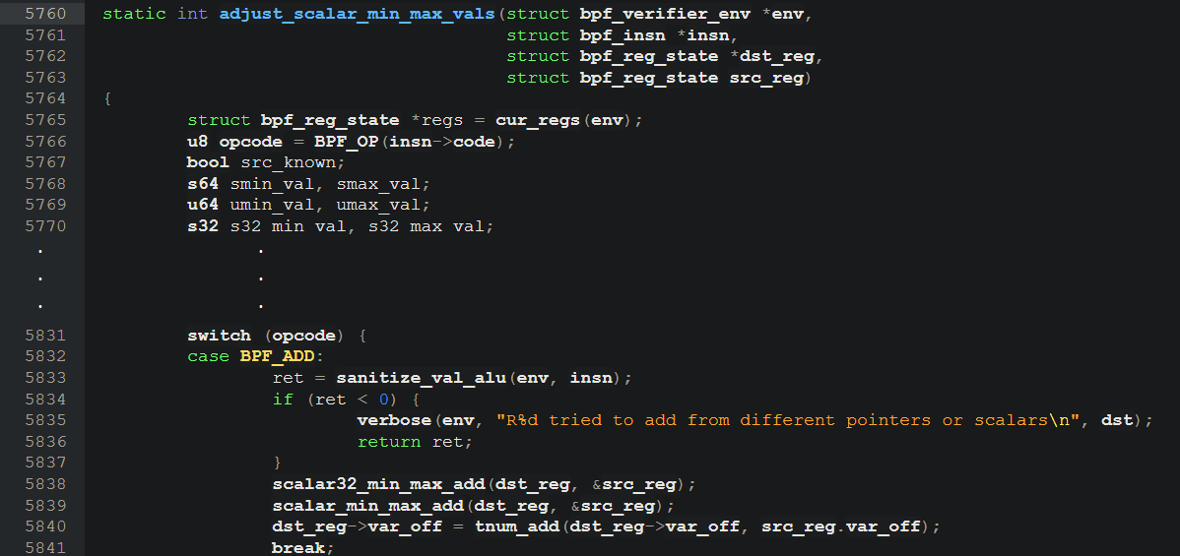
adjust_scalar_min_max_vals (5760-5919) case BPF_ADD: (5832-5841)
Does additional checks on 32-bit instructions, but otherwise assumes 64-bit instructions
Important part of the code is a switch that delegates to the appropriate scalar_min_max_[op] function

Slide 8
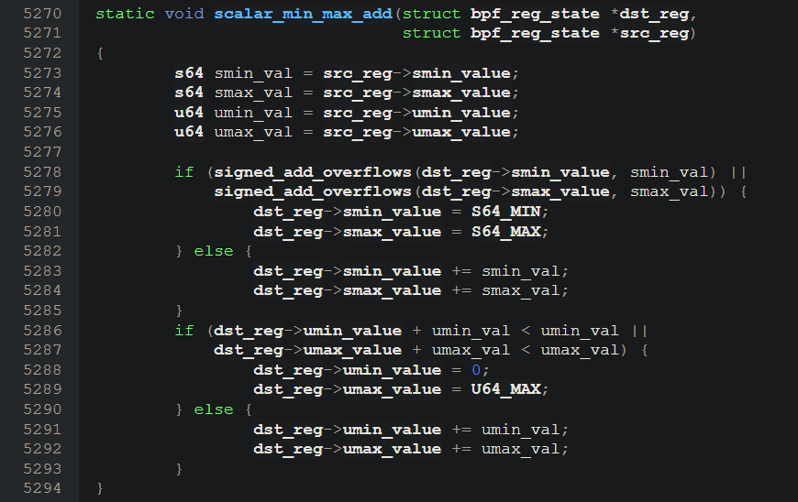
scalar32_min_max_add (5244-5268) scalar_min_max_add (5270-5294)
Basically the lowest level. No function calls.
Sets the register’s new signed and unsigned min/max values.

Slide 9
Other functions
The following functions are also called in various methods like adjust_scalar_min_max_vals and adjust_ptr_min_max_vals
zext_32_to_64 (zero extend a 32 bit number to a 64 bit number)
__update_reg_bounds
__reg_deduce_bounds
__reg_bound_offset

